Slide 1


Ready-to-use presentation
YouCanQuit2 Tobacco Education Campaign
Date:
Last Updated: October 2023

Slide 2
Presentation guide
The following ready-to-use presentation slides offer a high-level overview of the YouCanQuit2 campaign. This presentation is specifically designed for professionals to present to a professional audience, such as military treatment facility staff, tobacco cessation counselors, facilitators, program managers, and others who have interest in learning about the campaign and its resources.
Throughout this deck you’ll find highlighted sections for users to personalize and add relevant local information. Be sure to also update the cover page title and *footers for your use.
If you are presenting and would like a more in-depth background of all information and resources related to YouCanQuit2, it may be helpful to review the following materials beforehand:
  YouCanQuit2 Campaign Toolkit
  YouCanQuit2 Campaign Overview Video
Looking for additional information or have questions? Please email the team: dha.ncr.comm.mbx.u-can-quit-2-quit-tobacco@health.mil
Remove this slide for use

Slide 3
Table of Contents
Youcanquit2 overview
03
Campaign resources
08
“The views expressed in this presentation are those of the author and do not necessarily reflect the official policy or position of the Department of Defense, nor the U.S. Government.”
Notes:
Today we will be going through some information about the DoD’s YouCanQuit2 tobacco education campaign and its available resources.
DISCLAIMER: The views expressed in this presentation are my own and do not necessarily reflect that of the DoD or the government.

Slide 4
YouCanquit2 overview www.ycq2.org

Slide 5
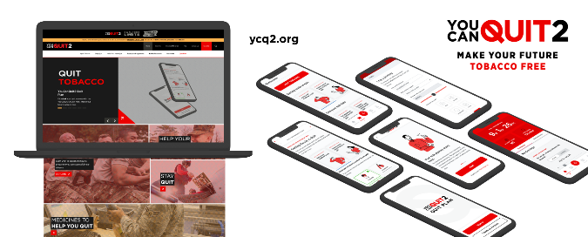
About youcanquit2
YouCanQuit2 is a DoD education campaign, aligned to the Defense Health Agency, to help Service members quit tobacco—for themselves and their loved ones
DoD originally launched the YouCanQuit2 (formerly Quit Tobacco – UCanQuit2 or Quit Tobacco – Make Everyone Proud) campaign in 2007
  Rebranded to YouCanQuit2 in April 2019 to include a refreshed name, new tagline, branding, and a new website
Notes:
Some background on YouCanQuit2 here. YouCanQuit2 is the DoD’s tobacco education campaign. It was originally launched in 2007, you may have known it as “Quit Tobacco – UCanQuit2” or “Quit Tobacco – Make Everyone Proud.” It was relaunched and rebranded in 2019 with a refreshed name, tagline, branding, and website. The campaign’s goals are to:
Encourage and support Service members to quit all forms of tobacco and stay quit
Support the DOD’s efforts to build and sustain a ready and resilient force by providing resources for Service members, their friends and family, and professionals
Support professionals, tobacco cessation facilitators, health educators, and other who provide programs and support that are critical in helping tobacco users successfully quit

Slide 6

Why is it important to address tobacco use?
Tobacco use threatens military readiness and discipline, and the mental and physical resilience of Service members
Service members face unique challenges including deployment, combat, time away from family, and increased stress—all of which may lead them to turn to using substances, like tobacco, to cope
Tobacco use may result in:
  Decreased physical fitness ¹⁻²
  Reduced night vision and accelerated hearing loss ³⁻⁵
  Increased absenteeism and loss of workdays ⁶
  Increased risk of injury and of hospitalization after injury ⁶
Notes:
So why is it important to address tobacco use? We know that tobacco use threatens military readiness, discipline, and resilience. Service members are exposed to unique challenges such as deployment, combat, time away from family, and generally increased stress that may cause them to turn to use tobacco to cope. Tobacco use can lead to decreased physical fitness, reduced night vision and accelerated hearing loss, increased absenteeism and loss of workdays, and increased risk of injury and hospitalization after injury.

Slide 7
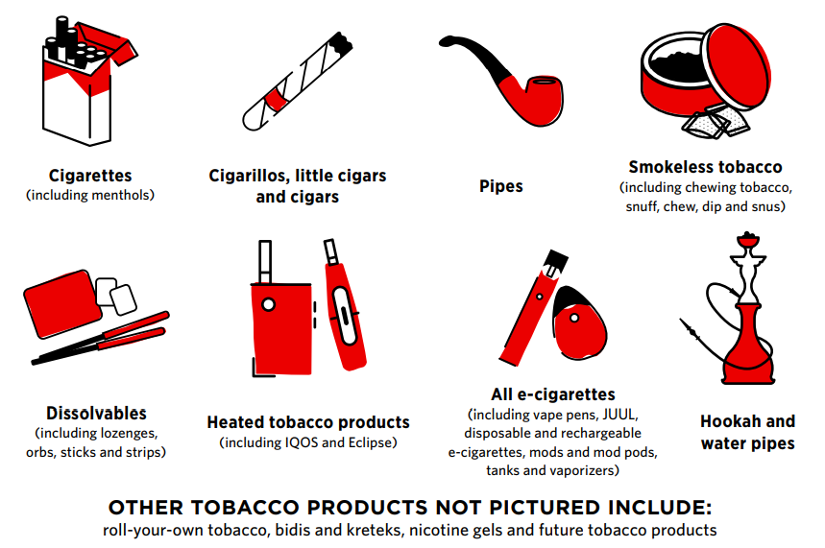
Tobacco products
Notes:
YouCanQuit2 covers all types of tobacco, the majority of which you’ll see illustrated here: cigarettes, cigarillos, pipes, smokeless tobacco, dissolvables, heated tobacco products, all e-cigarettes, hookah and water pipes, and types not pictured here like roll-your-own tobacco, bidis and kreteks, nicotine gels, and all future tobacco products.

Slide 8

Youcanquit2 Meets service members where they are
YouCanQuit2 supports the DoD’s efforts to build and sustain a ready and resilient force by providing resources and information to Service members, as well as their family and friends and health professionals
Although YouCanQuit2’s target audience is 18-24-year-old enlisted Service members, the campaign is a resource for all Service members regardless of age, rank, Component, or Service branch
YouCanQuit2 is established in a .org web space due to topic sensitivity. Service members can access the site on any device 24/7
The campaign is not a TRICARE® program and is not tied to TRICARE benefits – the resources are available to all Service members as well as professionals, family, and friends
Notes:
The campaign was created to meet Service members where they are. It supports the DoD’s efforts to build and sustain a ready and resilient force by providing resources and information to Service members, as well as their family and friends and health professionals. YouCanQuit2’s primary target audience is 18 to 24 enlisted Service members, but the campaign’s resources can be utilized by all Service members regardless of age, rank, component, or Service branch. The YouCanQuit2 website is established in a .org webspace instead of .mil due to topic sensitivity and anyone can access the site on any device 24/7. The campaign resources are available to all Service members, professionals, family, and friends – it is not a TRICARE program and is not tied to TRICARE benefits.

Slide 9
Campaign resources

Slide 10
Campaign Website sections
Campaign Website sections
Quit Tobacco. Find articles about preparing to quit tobacco, including information about writing a quit plan, and medications to use while quitting tobacco
Stay Quit. Find articles about staying quit, including information about managing tobacco cravings, reducing stress, and preventing weight gain
Help Your Hero Quit. Find information for friends, family, and anyone helping to support someone is who quitting tobacco – at any stage in their quit journey
Tobacco and E-Cigarettes. Find the most recent facts, tips, and resources on nicotine and newer tobacco products including e-cigarettes
Resources for Quitting. Find interactive tools and resources for quitting tobacco
Notes:
When you visit the YouCanQuit2 website, you’ll find that it’s divided into multiple sections. You can access each section from the homepage. The first section is called “Quit Tobacco” where one would find articles about preparing to quit tobacco, including information about writing a quit plan, and medications to use when quitting tobacco. In “Stay Quit” one can find articles about staying quit, including information about managing tobacco cravings, reducing stress, and preventing weight gain. In the “Help Your Hero Quit” section there is information for friends, family, and anyone helping to support someone is who quitting tobacco - at any stage in their quit journey. In “Tobacco and E-Cigarettes” one can find the most recent facts, tips, and resources on nicotine and newer tobacco products including e-cigarettes. The last section “Resources for Quitting” offers interactive tools and resources for quitting tobacco that we’ll discuss more in detail later.

Slide 11
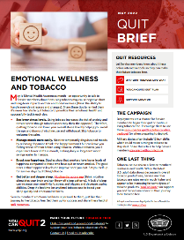
Using YouCanquit2 as a professional
Check out resources in the For Professionals section of the website
Review the Campaign Toolkit, a one-stop-shop for all things related to the YouCanQuit2 campaign
Subscribe to the Quit Brief e-Newsletter
  Visit ycq2.org and click “Contact Us” in the bottom right-hand corner to send the campaign a message. Select “Sign up for our e-Newsletter” as subject
Order free bulk print and promotional materials
Use ready-to-use messaging in your next POM/POD/POW, newsletter or email
Link to us on your website using the available graphics and HTML code
Notes:
There are numerous ways that professionals can use the YouCanQuit2 campaign to support their efforts in educating Service members about tobacco. There is actually a dedicated For Professionals section of the YouCanQuit2 website where professionals like yourselves can find resources.
In that section, you’ll find the YouCanQuit2 Campaign Toolkit, a one-stop-shop for all things related to the campaign. You can subscribe to the Quit Brief e-newsletter to get bimonthly updates on the campaign and valuable resources sent directly to your inbox. Take advantage of the campaign’s free bulk print and promotional materials to get free campaign materials sent directly to you at your installation or command. Use the ready-to-use messaging available for your next plan of the month/day/week notes, newsletters, or emails. You can also link to the campaign on your website using the available graphics and HTML code.

Slide 12
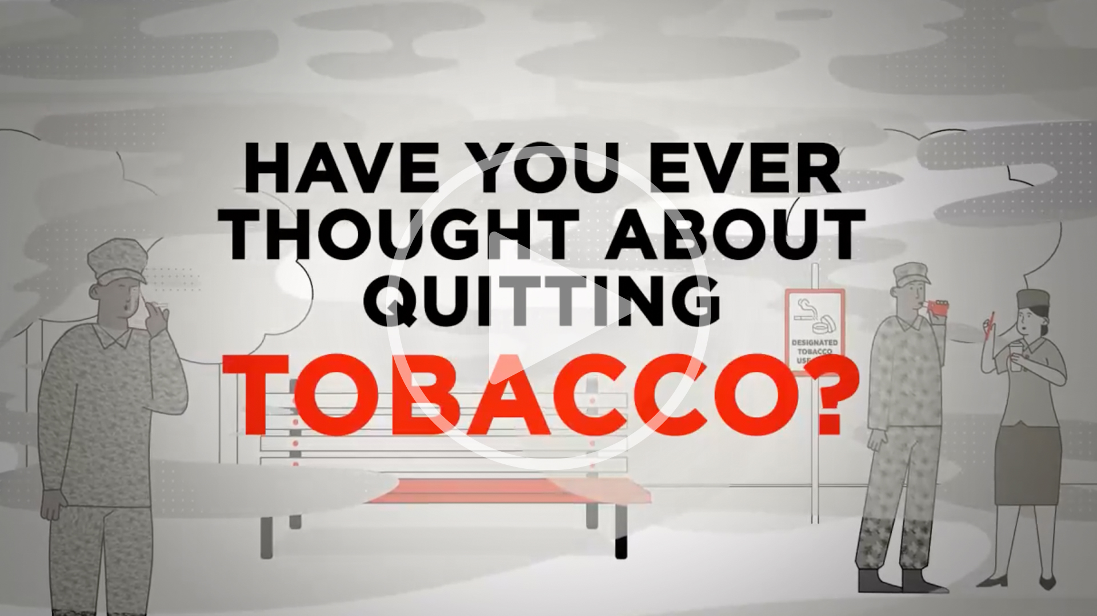
Campaign Videos
Stream or download videos including the Campaign Overview Video, The Harms of Vaping, and The Positive Impacts of Quitting Tobacco:
Notes:
Professionals can also stream or download any of the YouCanQuit2 videos including the Campaign Overview Video which offers an introduction to the campaign, The Harms of Vaping video which explains how and why Service members should protect themselves from the harmful risks of vape products, and the campaign’s newest video which we’ll watch here, The Positive Impacts of Quitting Tobacco (HIT PLAY IF YOUR SYTEM ALLOWS)

Slide 13

Resources for service members (1/2)
Support Locator: Helps Service members and others find resources and support for a variety of tobacco cessation needs. As a professional, you can also submit your resource or program for listing
Quit Plan: This mobile-first, app-like tool helps Service members make their future tobacco free. The interactive tool offers a step-by-step, customized plan for quitting tobacco and staying quit
Savings Calculator: Allows Service members to see how much money they will save by quitting cigarettes, smokeless tobacco, or e-cigarettes
Notes:
Under the “Resources for Quitting” section of the website that I mentioned earlier, you’ll find the interactive YouCanQuit2 Support Locator tool which serves as a searchable database that helps Service members and others find local resources and support for a variety of tobacco cessation needs. As a professional, you can also submit your resource or program for listing in the database.

Slide 14

Resources for service members (2/2)
Web articles featuring a variety of resources about different types of tobacco and the negative impacts, how to quit, and how to stay quit. Examples include:
Boost Healthy Habits While You Quit: Helps Service members learn more about building health habits for their body and mind while trying to quit tobacco
Are Triggers Killing Your Vibe?: Explains how Service members can avoid situations that may make them want to use tobacco and different strategies they can take to fight the urge
Smokeless Tobacco: Not a Quick Fix: Describes the different forms of smokeless tobacco and why using them isn’t a safer alternative to smoked tobacco
Power Through Nicotine Withdrawal: Offers tips on how to deal with the changes your body goes through during your quit journey
Notes:
Professionals can also utilize and share any of the available web articles on the YouCanQuit2 website. Find articles like Boost Health Habits While You Quit, which helps Service members learn more about building health habits for their body and mind while trying to quit tobacco; Are Triggers Killing Your Vibe?, which explains how Service members can avoid situations that may make them want to use tobacco and different strategies they can take to fight the urge; Smokeless Tobacco: Not a Quick Fix, which describes the different forms of smokeless tobacco and why using them isn’t a safer alternative to smoked tobacco; or Power Through Nicotine Withdrawal, which offers tips on how to deal with the changes your body goes through during your quit journey.

Slide 15
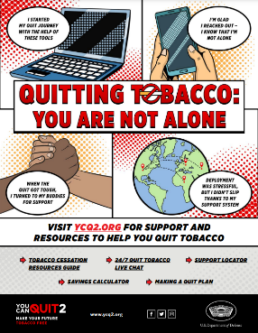
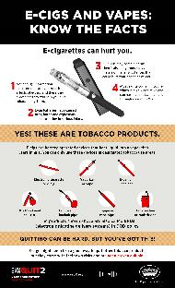
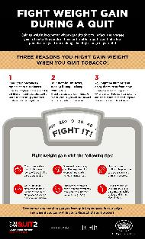
Downloadable resources
YouCanQuit2 has many downloadable resources that offer helpful information on quitting tobacco and staying quit such as:
Infographic Link
Poster Link
Infographic Link
Notes:
Professionals can also view/print/disseminate any of the YouCanQuit2 downloadable resources (posters, infographics, and fact sheets), many of which are also available for the free bulk ordering I mentioned earlier. These three materials here are examples of the many pieces available.

Slide 16
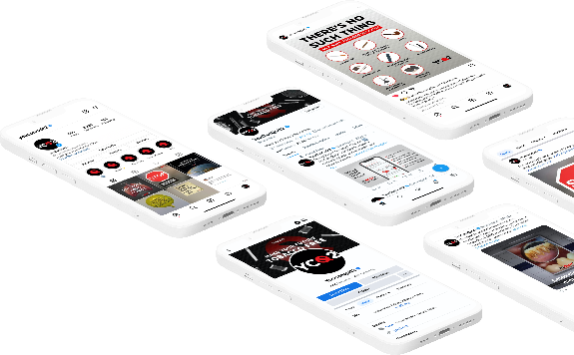

YouCanquit2 on Social Media
  Featuring engaging multimedia and resources for Service members that aim to create a community of support with the campaign and others who are quitting tobacco
  Find YouCanQuit2 on Facebook, Instagram, and Twitter​
Notes:
YouCanQuit2 is also on social media. The Facebook, Instagram and Twitter accounts feature engaging multimedia and resources that aim to create a community of support with the campaign and others who are quitting tobacco.

Slide 17

Local Information
**Use this slide to add relevant local contact information for tobacco cessation programs and POCs, news, and updates below:
News
Updates
**Remove for use

Slide 18

Contact The Youcanquit2 Team
Let the team know how you’re using the campaign to work with Service members at your installations! Please reach out with any questions or content needs.
Email: dha.ncr.comm.mbx.u-can-quit-2-quit-tobacco@health.mil
Notes:
The YouCanQuit2 team wouldn’t be successful without the feedback and collaboration they have with the Services and professionals. They want to hear from you to understand how you may be using the campaigns to work with Service members. Please reach out to them with any questions, requests for information, or new ideas for specific resources.

Slide 19
References
1 https://pubmed.ncbi.nlm.nih.gov/21624940/ ​
2 https://pubmed.ncbi.nlm.nih.gov/26506188/ ​
3 Durazzini G, Zazo F, and Bertoni G. The importance of the dosage of thiocyanates in urine and blood of flying personnel for the prevention of diseases of visual function. In Medical Requirements and Examination Procedures in Relation to the Tasks of Today's Aircrew, edited by G. Perdriel. London, UK: NATO Advisory Group for Aerospace Research and Development. 1975.​​
4 Cruickshanks KJ, Klein R, Klein BE, Wiley TL, Nondahl DM, Tweed TS. Cigarette smoking and hearing loss: the epidemiology of hearing loss study. JAMA. 1998;279(21):1715-1719. ​
5 https://pubmed.ncbi.nlm.nih.gov/25761183/ ​
6 https://www.ncbi.nlm.nih.gov/books/NBK215333/ doi: 10.17226/12632

Slide 20



Closing slide
Visit us
www.ycq2.org
Check out our other campaigns
www.ownyourlimits.org
www.toomuchtolose.org

